Slide 1







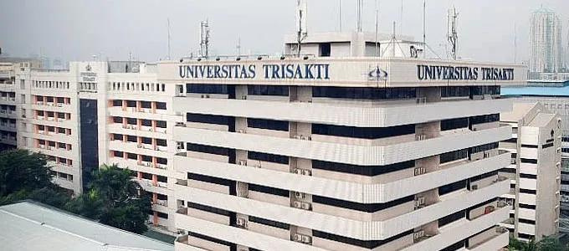






FAKULTAS HUKUM
UNIVERSITAS TRISAKTI
1ST TRAILS 2023
TRISAKTI INTERNATIONAL CONFERENCE ON LAW FOR SOCIAL WELFARE
SEPTEMBER 25TH – 26TH , 2023
Title title title title
....................
Authors affiliation
.......................

Slide 2

FAKULTAS HUKUM
UNIVERSITAS TRISAKTI
TABLE OF CONTENT
  Introduction
  Methods
  Results and Discussion
  Conclusion
  Recommendation

Slide 3

FAKULTAS HUKUM
UNIVERSITAS TRISAKTI
INTRODUCTION
Marketing agency is an agency engaged in marketing. This means that this company will help brand or business owners who need help in determining the right marketing strategy. There are several benefits that business owners can feel when using the services of this marketing agency.
www.reallygreatsite.com

Slide 4
FAKULTAS HUKUM
UNIVERSITAS TRISAKTI
INTRODUCTION
Marketing agency is an agency engaged in marketing. This means that this company will help brand or business owners who need help in determining the right marketing strategy. There are several benefits that business owners can feel when using the services of this marketing agency.
www.reallygreatsite.com

Slide 5

FAKULTAS HUKUM
UNIVERSITAS TRISAKTI
METHOD
Step1
Step2
Step3
To create your own, choose a topic that interests you.
To create your own, choose a topic that interests you.
To create your own, choose a topic that interests you.

Slide 6

FAKULTAS HUKUM
UNIVERSITAS TRISAKTI
RESULTS & DISCUSSION
  Marketing agency is an agency engaged in marketing.
  Marketing agency is an agency engaged in marketing.
  Marketing agency is an agency engaged in marketing.
  Marketing agency is an agency engaged in marketing.

Slide 7

FAKULTAS HUKUM
UNIVERSITAS TRISAKTI
RESULTS & DISCUSSION
  Marketing Analysis
  Strategy Mnagement
Marketing agency is an agency engaged in marketing.
Marketing agency is an agency engaged in marketing.
  Accompaniement
  Financial Analysis
Marketing agency is an agency engaged in marketing.
Marketing agency is an agency engaged in marketing.

Slide 8
FAKULTAS HUKUM
UNIVERSITAS TRISAKTI
RESULTS & DISCUSSION
Item 5
20%
Item 1
20%
Profits from current production (corporate profits with inventory valuation and capital consumption adjustments) decreased $66.4 billion in the first quarter, in contrast to an increase of $20.4 billion in the fourth quarter.
Q1 2022 ( 2nd)
2.4%
Item 4
20%
Item 2
20%
Q2 2022 ( 2nd)
2.5%
Item 3
20%

Slide 9


FAKULTAS HUKUM
UNIVERSITAS TRISAKTI
RESULTS & DISCUSSION
Results
Discussion1
Discussion2
To create your own, choose a topic that interests you.
To create your own, choose a topic that interests you.
To create your own, choose a topic that interests you.

Slide 10

FAKULTAS HUKUM
UNIVERSITAS TRISAKTI
CONCLUSION
  This means that this company will help brand or business owners who need help in determining the right marketing strategy.
  This means that this company will help brand or business owners who need help in determining the right marketing strategy.

Slide 11

FAKULTAS HUKUM
UNIVERSITAS TRISAKTI
RECOMMENDATION
  This means that this company will help brand or business owners who need help in determining the right marketing strategy.
  This means that this company will help brand or business owners who need help in determining the right marketing strategy.

Slide 12



FAKULTAS HUKUM
UNIVERSITAS TRISAKTI
THANK YOU
123 Anywhere St., Any City
+123-456-7890
www.reallygreatsite.com

